Slide 1
GroomShield
Detecting Grooming-Related Interactions in Chat Conversations Using DistilBERT and LSTM-Based Behavioral Sequence Modeling
Notes:
Good day. GroomShield asks whether a moderation system can identify concerning chat conversations by following how the exchange develops. We combine contextual language analysis with an LSTM that learns from the ordered conversation. I will first show how the study aligns with our objectives, then explain the method and the results.
Sources: thesis_docs/Finals_Revised_Paper_WASD.md, title and Sections 1.2-1.3.

Slide 2


Notes:
This work was completed by Andrei Torres, Don Idos, Justin Arroco, and Michael Maala under the guidance of Manuel Calimlim Jr. Our focus was to build a working moderation module and test whether it finds more positive conversations than simpler comparison methods.
Sources: original presentation team slide.

Slide 3

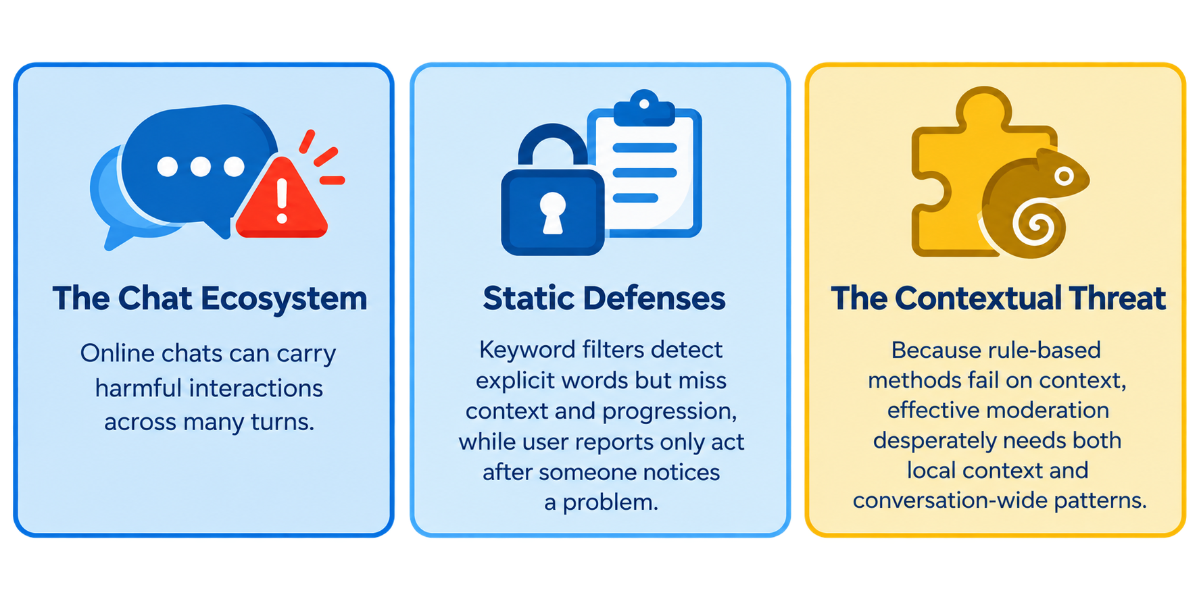
Project Context
Core Question: How effective are existing chat moderation systems, and how can ML and NLP analyze behavior across an entire conversation?
Notes:
In modern chats, harmful interactions don't happen in a single message—they build over time. Our current defenses are like digital bouncers looking for obvious explicit words; they catch profanity but completely miss the context. And relying on user reports? That only works after the damage is already done. The real threats hide in the gray areas where these static rules fail. To actually protect users, moderation needs to see the whole picture. So, our core question is: how can we use machine learning to analyze behavior across an entire conversation?

Slide 4
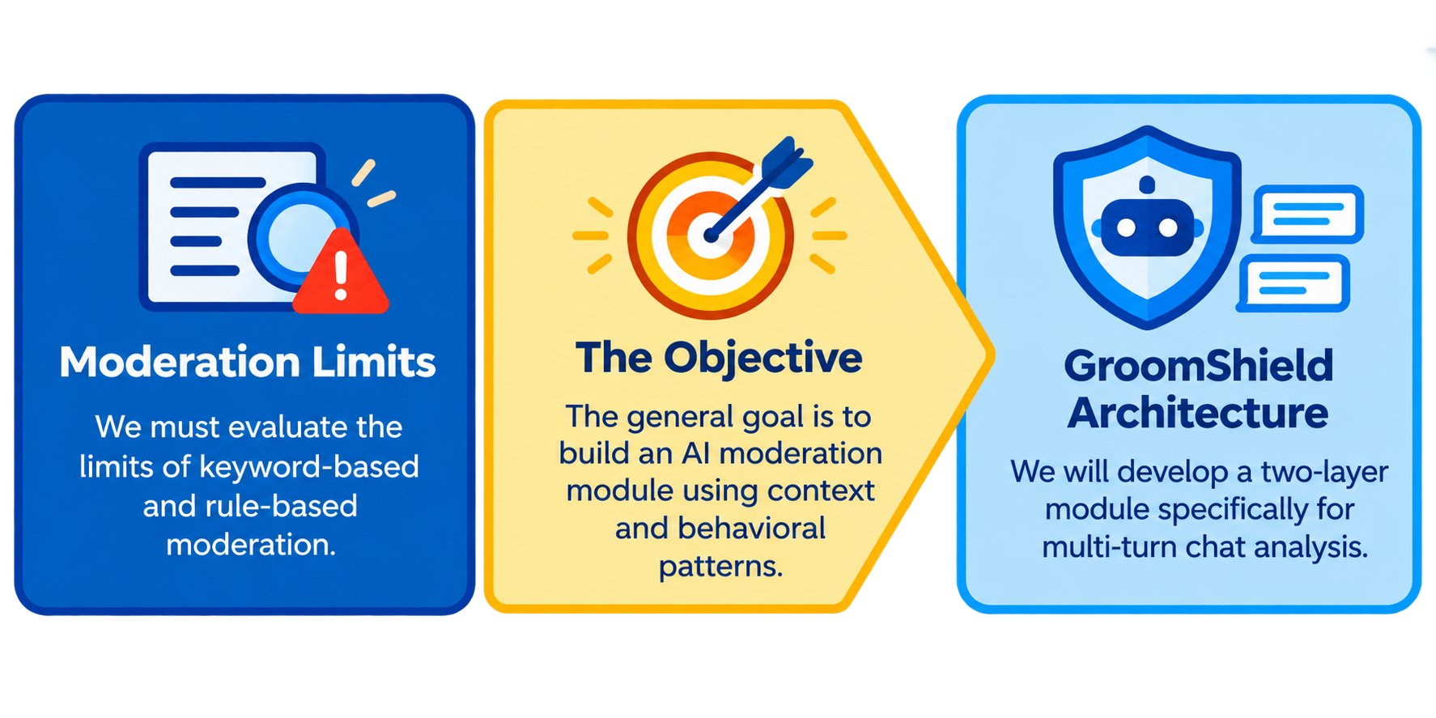
The Moderation Blind Spot
The Benchmark: This study provides a controlled, direct comparison between a Trajectory-Feature LSTM and traditional keyword/static-score aggregation using the PAN-2012 evaluation corpus.
Notes:
So, whats the blind spot? First, we have to prove exactly where these traditional, rule-based systems fail. Because they treat every message in a vacuum. Our main objective is to bridge that gap by building an AI module that actually tracks context and behavioral patterns. We are developing a two-layer architecture built specifically for multi-turn chat analysis. The ultimate benchmark? Measuring exactly how much this system improves recall and gets rid of false negatives compared to the old, static way of doing things.

Slide 5
Alignment Table
Problem | Question / Objective | Method | Results evidence | Status
How well do existing systems detect relevant conversations? | RQ1 / Objective 1: Evaluate existing moderation. | Test the keyword rule on the same held-out conversations. | Keyword rule: 61.36% recall and 17 missed cases. | Achieved
Static methods can miss meaning that develops across turns. | RQ2 / Objective 1: Examine the limits of static methods. | Compare keyword and score aggregation with the trajectory LSTM. | LSTM gains over maximum Layer 1: +0.3630 PR-AUC and +0.1958 F2. | Achieved
Chat analysis needs both context and behavioral development. | RQ3 / Objective 2: Develop the AI moderation module. | Combine DistilBERT, seven trajectory features, and an LSTM. | Completed two-layer module and sequential review interface. | Achieved
The module must improve detection and reduce missed cases. | RQ4 / Objective 3: Measure recall and false-negative reduction. | Use F2 and compare results with other methods. | Trajectory-Feature LSTM: Used F2. 93.18% recall and three misses; 50% fewer misses than weighted scoring. | Achieved
Notes:
For the first objective, we needed concrete comparators. We implemented a keyword rule and a method that takes the highest contextual score seen in a conversation. Both were tested on the same held-out conversations as the sequence models. The keyword rule found 27 of the 44 positives and missed 17. That result gives us a measured baseline for the question about static moderation. We did not run a separate field trial of an operational user-report system.
Sources: Alignment Table.docx, rows 1-2; thesis_docs/CHAPTER_IV_RESULTS_AND_DISCUSSION.md, Tables 4.1-4.2

Slide 6
AI Model Architecture
Layer 1: DistilBERT
Author-derived
proxy score
Layer 2 inputs
Seven behavioral
features
Embedding variant:
+ 768 text values
Layer 2: LSTM
7 or 775 inputs
Ordered sequence
Current turn
+ up to two
previous turns
Fixed base encoder
Current-turn embedding
+ training reference
Conversation score
F2-selected cutoff
Human review
Two input variants; each new turn updates the conversation score.
Notes:
Each new turn enters with nearby conversational context. Layer 1 produces an author-derived proxy score, and the fixed encoder supplies a text embedding. Seven trajectory features summarize the developing conversation. One LSTM uses the seven features; the other receives those features plus the embedding. Each produces a conversation score for a validation-selected cutoff and human review. The turn-level score is an input to the system, not a verified label that grooming began at that message.
Sources: thesis_docs/Finals_Revised_Paper_WASD.md, Sections 3.3.2-3.4.2; thesis_docs/assets/AI_Model_Architecture_Diagram.svg.

Slide 7
Results
Method | PR-AUC | F2 | Precision | Recall | FP | FN
Keyword rule | 44.51% | 63.08% | 71.05% | 61.36% | 11 | 17
Maximum Layer 1 | 55.23% | 66.55% | 33.33% | 88.64% | 78 | 5
Weighted scorer | 80.50% | 79.83% | 61.29% | 86.36% | 24 | 6
Trajectory-Feature LSTM | 91.53% | 86.13% | 66.13% | 93.18% | 21 | 3
Embedding-and-Feature LSTM | 94.83% | 84.29% | 51.76% | 100.00% | 41 | 0
N = 1,862; 44 positive. Validation-selected F2 cutoffs on saved test scores.
Notes:
This table gives the main F2 result. The Trajectory-Feature LSTM found 41 of 44 positives and missed three, while producing 21 false alerts. The Embedding-and-Feature LSTM found all 44, with 41 false alerts. Both exceed the weighted scorer's 38 detections, although the two LSTMs make a different coverage-versus-workload trade-off. For the matched seven-feature comparison, the trajectory model also has stronger PR-AUC and F2 than the weighted scorer; the paired analysis behind that comparison appears shortly.
Sources: thesis_docs/CHAPTER_IV_RESULTS_AND_DISCUSSION.md, Tables 4.1-4.2

Slide 8
Missed Positives and False Alerts
7-feature LSTM: 3 misses and 21 false alerts. 775-input LSTM: 0 misses and 41 false alerts.
Notes:
This graph turns the result into conversation counts. The trajectory model reduces the weighted scorer's six misses to three while also lowering false alerts from 24 to 21. The embedding model reaches zero misses on these 44 positives, with 41 false alerts. That is the coverage-versus-review-workload decision behind our threshold comparison. These are whole conversations, not individual messages.
Sources: thesis_docs/CHAPTER_IV_RESULTS_AND_DISCUSSION.md, Table 4.1 and Section 4.7.

Slide 9
Cutoff Choice: Coverage and Alerts
Model | Policy | Found | Missed | False positives | Precision | Recall
Embedding-and-Feature LSTM | F0.5 | 41 | 3 | 6 | 87.2% | 93.2%
 | F1 | 43 | 1 | 14 | 75.4% | 97.7%
 | F2 | 44 | 0 | 41 | 51.8% | 100.0%
Trajectory-Feature LSTM | F0.5 | 40 | 4 | 7 | 85.1% | 90.9%
 | F1 | 40 | 4 | 9 | 81.6% | 90.9%
 | F2 | 41 | 3 | 21 | 66.1% | 93.2%
Notes:
These six rows use the same two trained LSTMs and the same saved test scores; only the validation-selected cutoff changes. For the embedding model, F1 finds 43 of 44 positives with 14 false alerts, while F2 finds all 44 with 41 false alerts. That last positive adds 27 alerts in this test. The trajectory model behaves differently: F1 adds two alerts over F0.5 without finding another positive. F2 remains our main recall-first reporting policy. The table shows why a later moderator-workflow study must choose its operating point deliberately.
Sources: thesis_docs/CHAPTER_IV_RESULTS_AND_DISCUSSION.md, Section 4.2.1 and Table 4.1a; thesis_docs/CHAPTER_V_SUMMARY_CONCLUSIONS_AND_RECOMMENDATIONS.md, Recommendation 7; thesis_docs/CHAPTER_IV_RESULTS_AND_DISCUSSION.md, Section 4.2.1 and Table 4.1a

Slide 10
Conclusion
GroomShield’s sequence models detected more positive conversations than the keyword, Layer 1, and weighted-scoring baselines.
The Embedding-and-Feature LSTM detected all 44 test positives, with a higher false-alert count.
Notes:
We can now answer the objectives directly. The static methods exposed measurable coverage and false-alert limits. We delivered the contextual and sequence-based module with a working review interface. Under F2, the trajectory model reduced weighted scoring's six misses to three, and the embedding model found all 44 positives with a larger alert workload. The matched-input paired result supports the benefit of sequence modeling. Together, these results advance the general objective of strengthening conversation-level review while making the cutoff trade-off explicit.
Sources: thesis_docs/CHAPTER_V_SUMMARY_CONCLUSIONS_AND_RECOMMENDATIONS.md, Sections 5.1-5.2

Slide 11
Recommendations
Test the fixed models on contemporary chats and measure the workload they create for moderators.
Compare the F1 and F2 cutoffs in that workflow to choose the right balance of coverage and alerts.
Evaluate early detection using independently annotated grooming-onset data.
Notes:
We can now answer the objectives directly. The static methods exposed measurable coverage and false-alert limits. We delivered the contextual and sequence-based module with a working review interface. Under F2, the trajectory model reduced weighted scoring's six misses to three, and the embedding model found all 44 positives with a larger alert workload. The matched-input paired result supports the benefit of sequence modeling. Together, these results advance the general objective of strengthening conversation-level review while making the cutoff trade-off explicit.
Sources: thesis_docs/CHAPTER_V_SUMMARY_CONCLUSIONS_AND_RECOMMENDATIONS.md, Sections 5.1-5.2

Slide 12
LIVE DEMO
Notes:
We would first test the fixed models and cutoffs on contemporary chats and measure how moderators handle the resulting queue. The embedding model's F1 and F2 settings are the clearest workflow comparison: one additional positive at F2 came with 27 additional alerts in this test. The three trajectory-model misses were short conversations, so fixed-prefix testing also deserves attention. Production work still needs longer chats and concurrent-load measurement; onset detection requires independent expert annotations.
Sources: thesis_docs/CHAPTER_V_SUMMARY_CONCLUSIONS_AND_RECOMMENDATIONS.md, Section 5.3, especially Recommendation 7; thesis_docs/PANEL_COMMENTS_MATRIX.md; thesis_docs/CHAPTER_IV_RESULTS_AND_DISCUSSION.md, Section 4.6

